Slide 1
Curricula, Research and Technology: Capacity Building for Graduate Nutrition and Dietetics in Puerto Rico
USDA NIFA Hispanic-Serving Institution Education Grant Program
Award No. 2017-38422-27112
Michelle Schelske-Santos, PhD; PD
Nancy Correa Matos, PhD, RD, LND; Co-PD

Slide 2
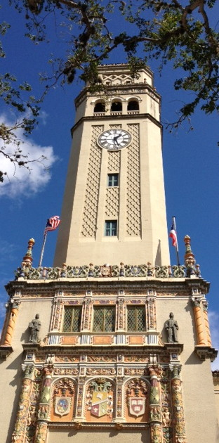
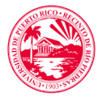
UPR, Río Piedras Campus, founded in 1903
Campus enrollment 2nd sem. 2017-18
13,193 total students
10,571 undergraduate (~$56./cr)
2,622 graduate (~$70./cr)
Tuition subject to increase
About 62% female, 38% male

Slide 3
UPR-RP, College of Natural Sciences
Undergraduate Enrollment: 1st sem. 2017-18
MATRÍCULA TOTAL PRIMER SEMESTRE 2017-2018
NUTR
TOTAL: 2,586

Slide 4
Curricula, Research and Technology: Capacity Building for Graduate Nutrition and Dietetics in Puerto Rico
OBJECTIVES
Complete the graduate program in nutrition and dietetics
Establish and equip the Nutrition Intervention Laboratory with state-of-the-art body composition and energy expenditure instrumentation
Establish and equip the Nutrition Technology Laboratory with computers and seating for students and equip faculty computers with webcams, to increase use of technology for instructional delivery and student learning
Perpetuate collaborative and inter-disciplinary relationships with other departments of the College of Natural Sciences, the Puerto Rico Department of Agriculture (PRDA), and the USDA Food and Nutrition Service (FNS)

Slide 5
Curricula, Research and Technology: Capacity Building for Graduate Nutrition and Dietetics in Puerto Rico
PARTNERS
Puerto Rico Department of Agriculture, Innovation Fund for Agricultural Development (Fondo de Inovación para el Desarrollo Agrícola, FIDA)
United States Department of Agriculture Food and Nutrition Service, FNS
Community practicum experiences in service to the underserved Hispanic population

Slide 6
Curricula, Research and Technology: Capacity Building for Graduate Nutrition and Dietetics in Puerto Rico
EXPECTED OUTCOMES
Increased student academic achievement in areas of critical thinking, understanding and application of the scientific method
Increased student research skills and projects in areas of nutrition sciences and clinical nutrition
Increased inter-departmental collaborative research among diverse Natural Sciences laboratories
Increased intra-campus collaborative projects with other colleges and departments like Psychology, Business Administration, Exercise Science
Increased extra-campus collaborative activities & research through PRDA and USDA FNS
More highly-skilled and knowledgeable entry-level dietitians for the workforce
Greater nutrition research to address specific health conditions of Hispanics
Greater consumption of locally produced fresh fruits and vegetables
Reduction in obesity, improvement in body composition and nutrition-related health

Slide 7
Curricula, Research and Technology: Capacity Building for Graduate Nutrition and Dietetics in Puerto Rico
ACTIVITIES / PROGRESS UPDATE
Development of new UPR model for the graduate degree in Nutrition and Dietetics (Bachelor’s integrated to Master’s + Dietetic Internship; MOU being drafted between Medical Sciences Campus and Río Piedras Campus)
Coordination of UPR-funded asbestos removal from future laboratory facilities with the Environmental Safety and Occupational Health Office
Establishing Scholarship Advisory Committee

Slide 8
Curricula, Research and Technology: Capacity Building for Graduate Nutrition and Dietetics in Puerto Rico
BEST PRACTICES
Dual-purpose initiatives amidst economic constraints:
1. faculty travel awards as incentives for graduate course creation (faculty development and curriculum development)
2. humanitarian aid project (Helping Hand) and student mentoring research scholarships (Mentor Me, Mentor Be!) to foster collaboration and integration of nutritional sciences into existing Natural Sciences departments to stimulate critical thinking (student mentoring and research development)

Slide 9
Curricula, Research and Technology: Capacity Building for Graduate Nutrition and Dietetics in Puerto Rico
CHALLENGES
Island-wide post-hurricane recuperation (instability in electricity, Internet, phone services)
Island-wide financial constraints and reducing UPR budget
Slow university administrative procedures
Graduating more students from B.S. in 4 years
Growing the program to meet student demand

Slide 10
Curricula, Research and Technology: Capacity Building for Graduate Nutrition and Dietetics in Puerto Rico
NEXT STEPS
Launch project web site
Launch the humanitarian aid project (Helping Hand) and student mentoring research scholarships (Mentor Me, Mentor Be!) program
Initiate graduate course development
Purchase scientific instrumentation, computers and materials for the two laboratories

Slide 11
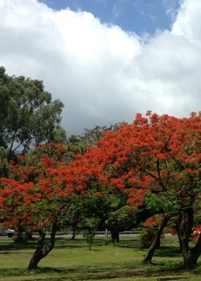
ACKNOWLEDGEMENTS
This work is supported by the Hispanic-Serving Institution Education Grant Program grant no. 2017-38422-27112/ project accession no. 1013635, from the USDA National Institute of Food and Agriculture.
Any opinions, findings, conclusions, or recommendations expressed in this publication are those of the author(s) and do not necessarily reflect the view of the U.S. Department of Agriculture.

